Slide 1
Selenium WebDriver Basic Usage
Python for ATQC
Oleksandr Reuta
SoftServe IT Academy
February, 2017

Slide 2
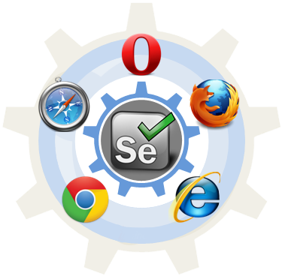
Agenda
Selenium Overview
Selenium IDE
Selenium Server
WebDriver Basic Usage
WebDriver API

Slide 3
Selenium Overview

Slide 4
Selenium (1/3)
Selenium is an open source testing tool to automate web applications across many platforms.
Selenium as a project started in June 2004.
Selenium was originally developed by Jason Huggins in 2004 as an internal tool at ThoughtWorks.
This tool is developed in Java Script and supports all the major browsers on all the platforms.
There are variants in selenium, which can be used to create automation suite for web application.

Slide 5
Selenium (2/3)
Selenium IDE is a Firefox add-on that makes it easy to record and playback tests in Firefox 2+. You can even use it generate code to run the tests with Selenium Remote Control.
Selenium Remote Control is a client/server system that allows you to control web browsers locally or on other computers, using almost any programming language and testing framework.
Selenium WebDriver can drive a browser natively either locally or on remote machines.
Selenium Grid takes Selenium Remote Control to another level by running tests on many servers at the same time, cutting down on the time it takes to test multiple browsers or operating systems.

Slide 6
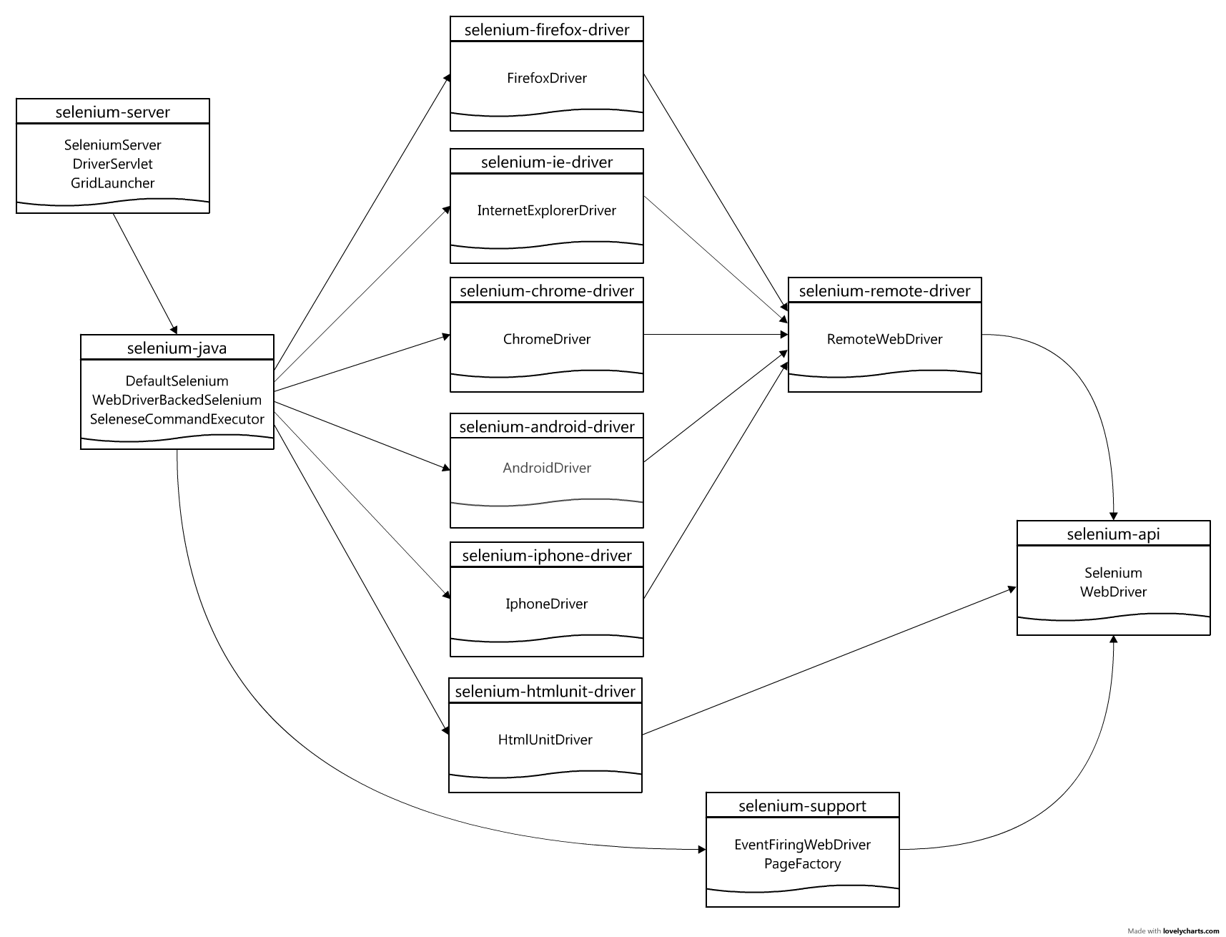
Selenium (3/3)
http://www.seleniumhq.org/download/maven.jsp

Slide 7
Selenium IDE

Slide 8
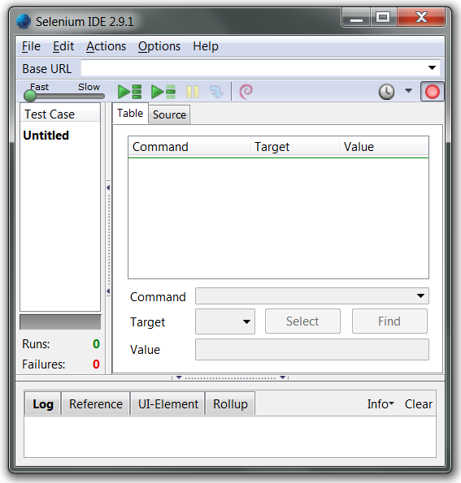
Selenium IDE Overview
Selenium IDE is an integrated development environment for Selenium tests.
It also serves as a starting point for automation.
Selenium IDE comes as Firefox extension, which allows recording, editing and debugging tests.

Slide 9
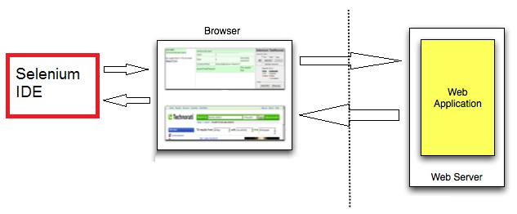
Selenium IDE Architecture
Simplified architecture diagram

Slide 10
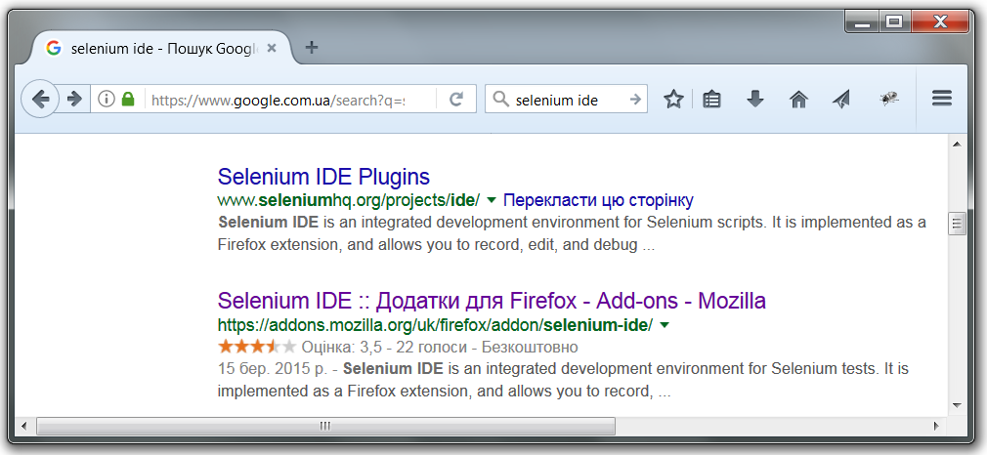
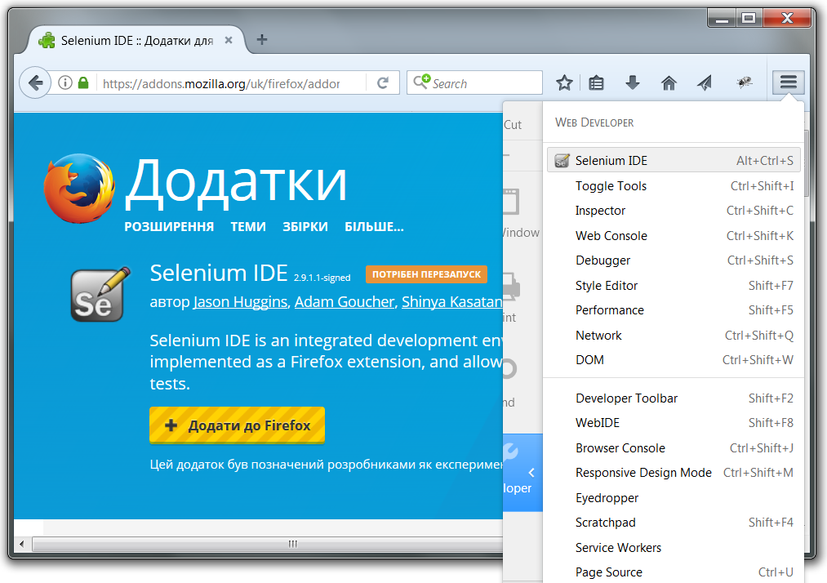
Selenium IDE Installation
Alt + Ctrl + S
1
4
6
2
3
5
Developer

Slide 11
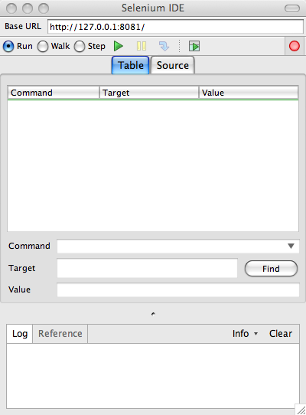
Selenium IDE Main Window (1/2)
The root of web application you want to test
The list of actions in the actual test case to execute
The log of the events that were executed, including any errors or warning that may have occurred
https://www.youtube.com/watch?v=gsHyDIyA3dg

Slide 12
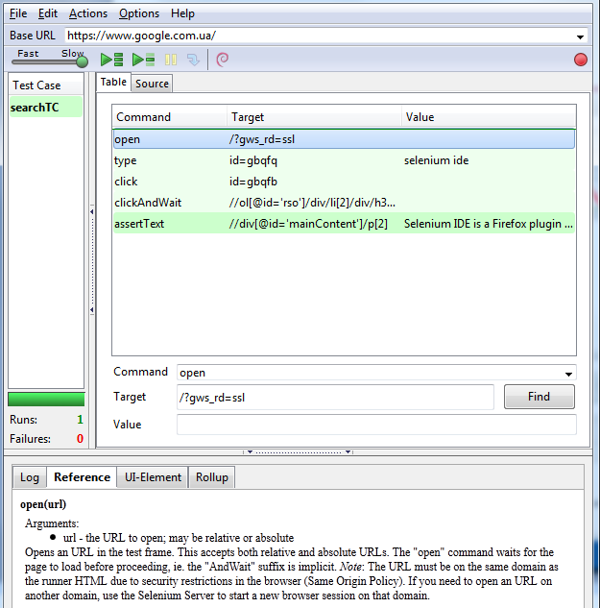
Selenium IDE Main Window (2/2)
Execution Commands
Record test actions
Try the test in the Web based TestRunner
Reference of the currently selected command
Specify commands, including asserts

Slide 13
Selenium IDE Usage
Selenium IDE is mainly used for record and play back.
Base URL in the IDE is used to specify the URL which is going to test.
Toolbar next to the base URL is used to record and play back the test.
The red circle in the toolbar is used to record the actions which are taken place in the web page.
Then the recorded test can be played using either "run current test" or "run entire test suite".
Test suite can also be played using Test runner, but it can play only html test.
Selenium speed can be controlled using slider of Selenium IDE.

Slide 14
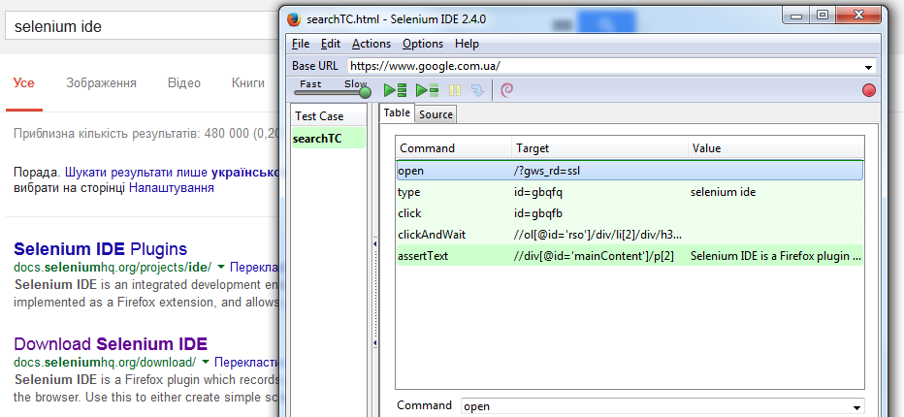
Selenium IDE Usage Example (1/4)

Slide 15
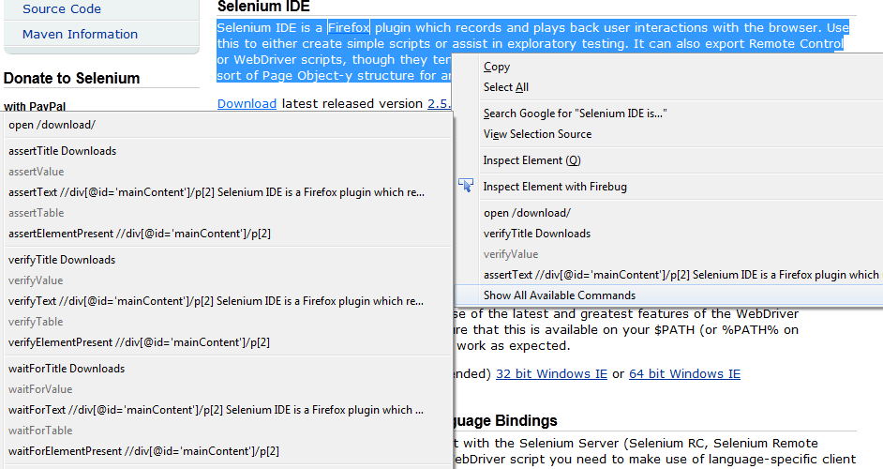
Selenium IDE Usage Example (2/4)

Slide 16
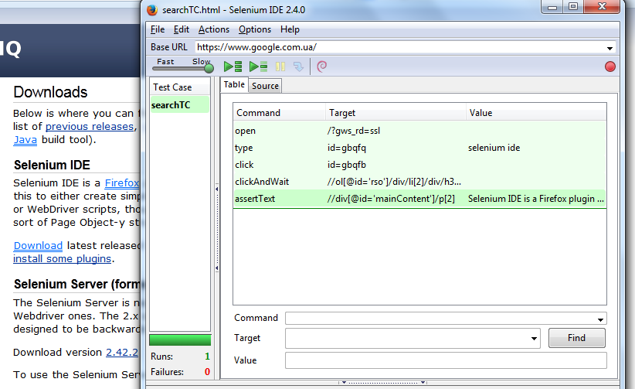
Selenium IDE Usage Example (3/4)

Slide 17
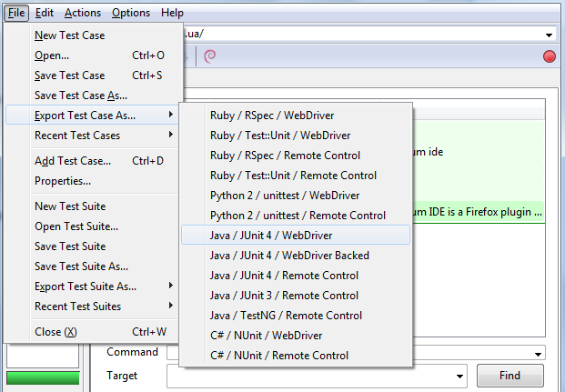
Selenium IDE Usage Example (4/4)

Slide 18
Selenium Server

Slide 19
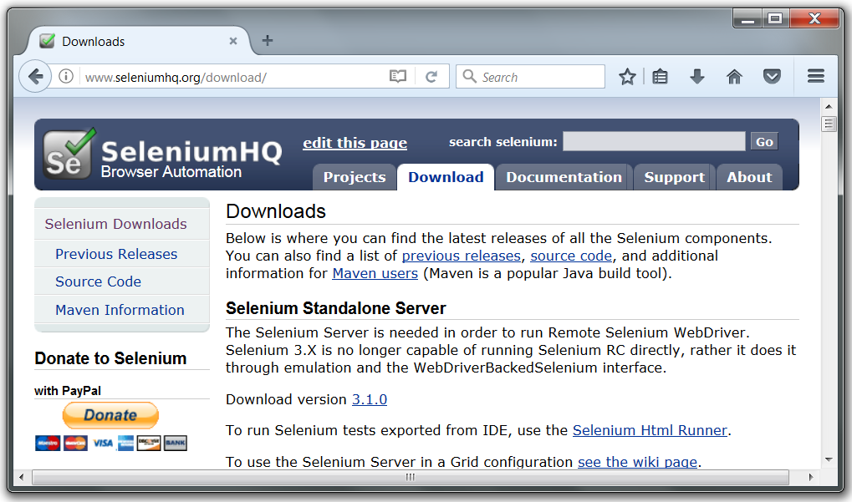
Selenium Server
http://seleniumhq.org/download/

Slide 20
Selenium Server (1/5)
Selenium Core tests run directly in a browser, just as real users do.
Selenium Core (Core) is a DHTML test execution framework.
It is the engine of both, Selenium IDE and Selenium RC (driven mode), but it also can be deployed on the desired application server.
Selenium Server (formerly the Selenium RC Server)
The Selenium Server is needed in order to run either Selenium RC style scripts.
The 2.x server is a drop-in replacement for the old Selenium RC server and is designed to be backwards compatible with your existing infrastructure.

Slide 21
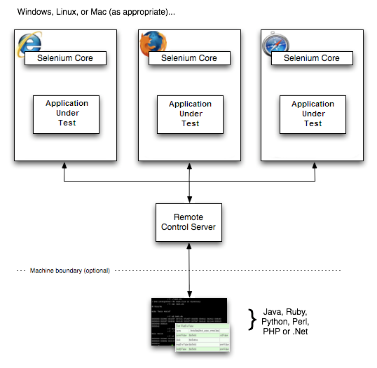
Selenium Server (2/5)
Simplified architecture diagram

Slide 22
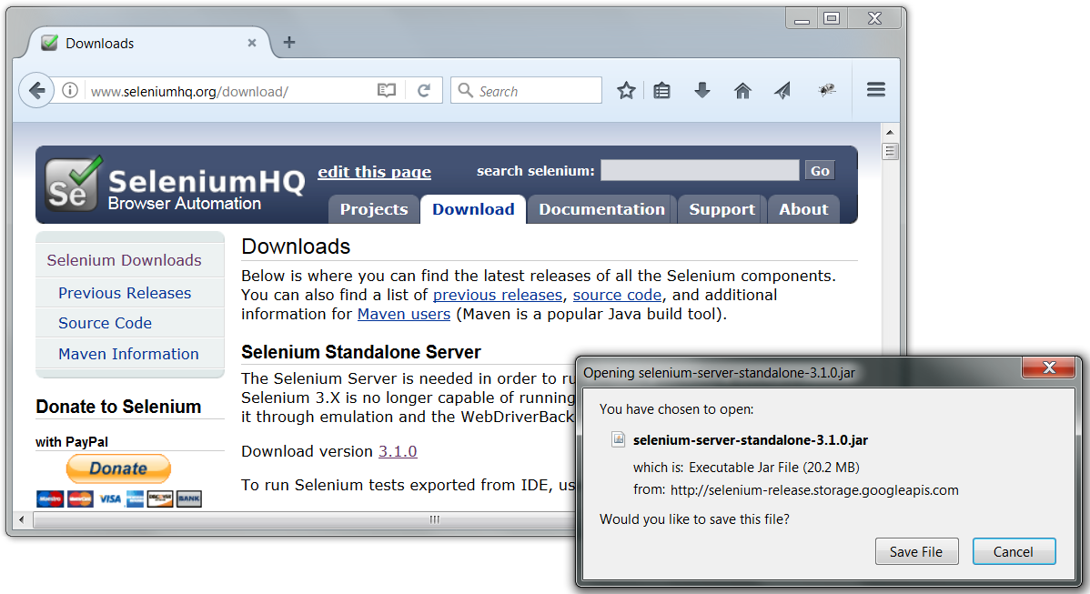
Selenium Server (3/5)
1
2
3

Slide 23
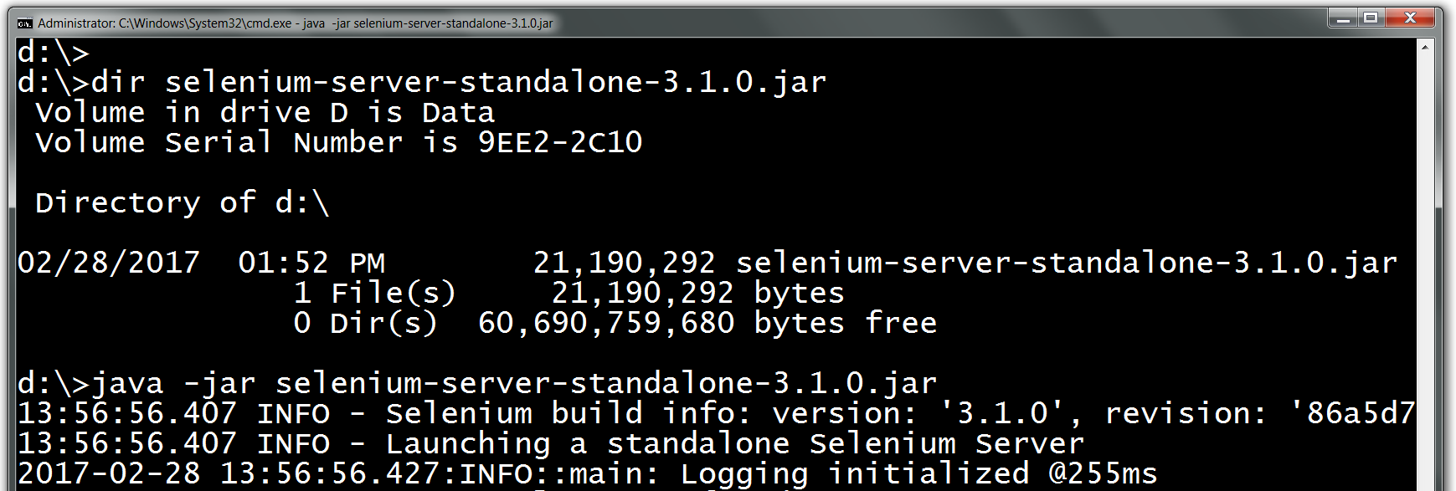
Selenium Server (4/5)
Start the server with the following console command:
java -jar selenium-server-standalone-3.1.0.jar
… output in the middle is cut …
Press Ctrl + C to stop the server

Slide 24
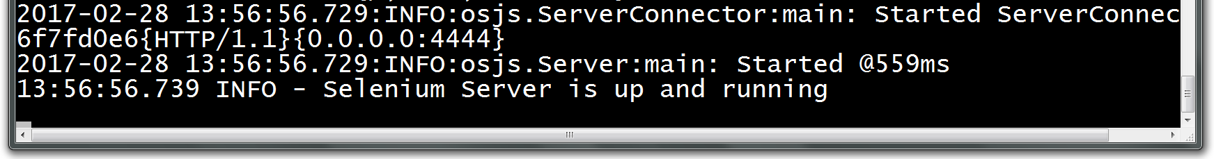
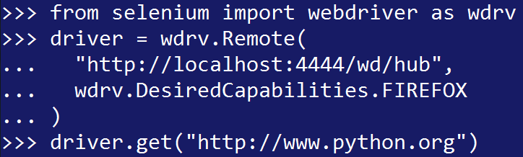
Selenium Server (5/5)
1. Check the port number listed by the server (4444 in this case):
2. Create Webdriver instance using method Remote()
This open a new tab in the browser
This load the desired page in the tab

Slide 25
Selenium Grid
Selenium Grid is a tool that speeds up functional testing of web-apps. It allows running multiple tests in parallel, on multiple machines, in a heterogeneous environment.
Selenium Grid coordinates multiple selenium remote control servers, so that test can be run on different platforms concurrently, which saves time and allows wider testing.
Scripts running too slow or want to run them against multiple browser types and versions?
Selenium Grid can help distribute script execution for either parallelization or browser variation.

Slide 26
WebDriver Basic Usage

Slide 27
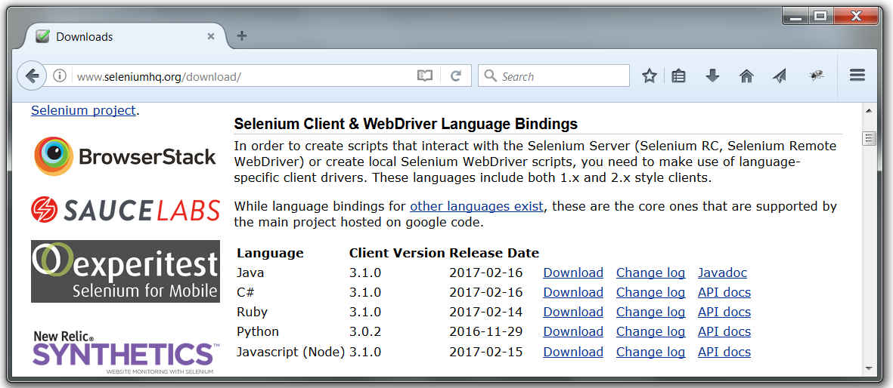
WebDriver Installation
Download Selenium WebDriver for Python

Slide 28
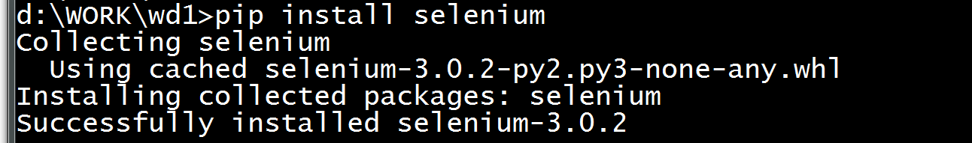
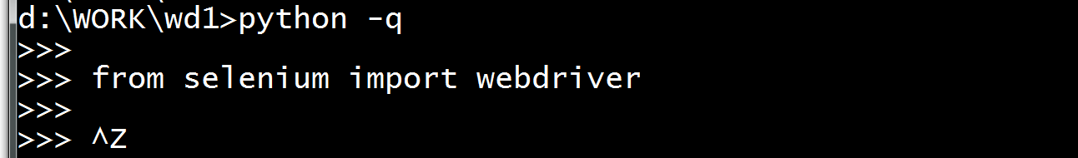
Check WebDriver installation
1. Install Selenium Binding:
2. Check Selenium installation:
3. Check WebDriver usage:

Slide 29
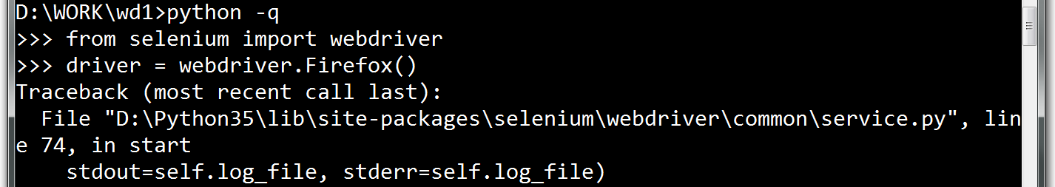
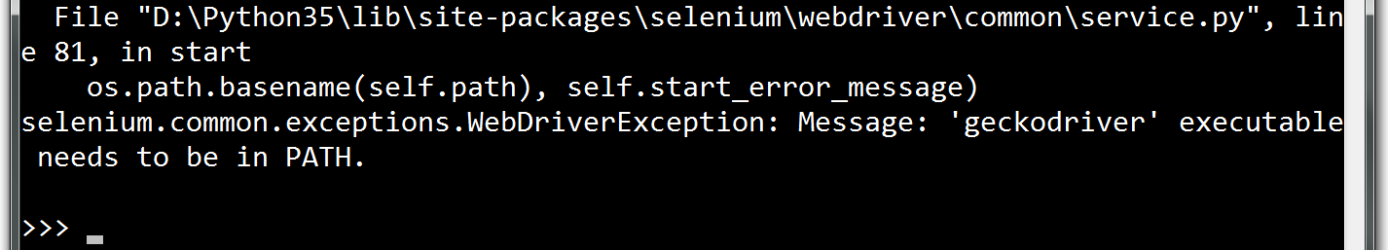
Marionette Proxy Error
If you get this error:
…some output in the middle has been cut off…
download and place into your PATH the file:

Slide 30
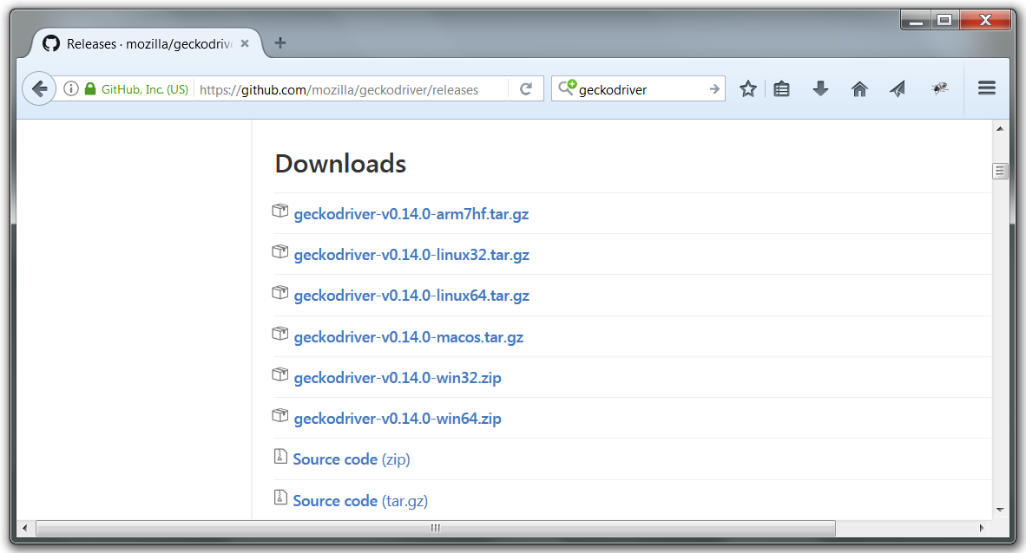
Marionette Proxy Download Page
https://github.com/mozilla/geckodriver/releases

Slide 31
Interaction to Browser
WebDriver directly addresses to the browser.
Uses drivers for a particular browser.
There are the following drivers:
FirefoxDriver – displays the web page in this browser;
InternetExplorerDriver;
ChromeDriver;
OperaDriver;
SafariDriver;
HtmlUnitDriver – cross-platform driver java, does not require any browser, the best choice for speed, but not the graphics;
AndriodDriver;
IphoneDriver.

Slide 32
Basic Use Cases
Types of tests
Testing static content
Correctly titled page;
Does the home page necessary picture?
There is contact information;
Beginning of each page with the tag title <h1>;
Does this title correct text?
Testing links
Transition for each link, check
Testing functionality
Transmission and receipt of results
Testing of dynamic elements
<input type="checkbox" value="true"
id="addForm:_ID74:_ID75:0:_ID79:0: checkBox"/>

Slide 33
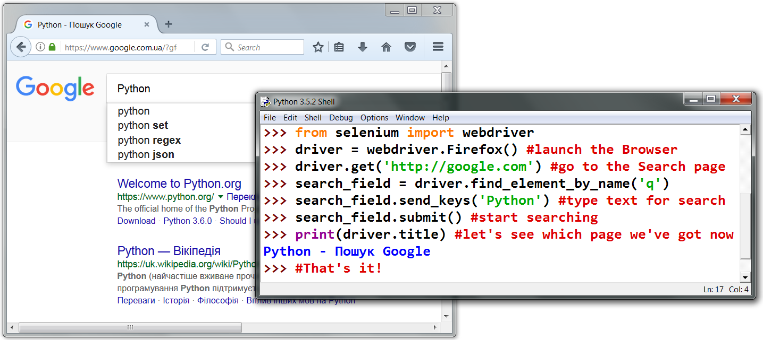
Basic Usage Example
Chrome
driver.close()

Slide 34
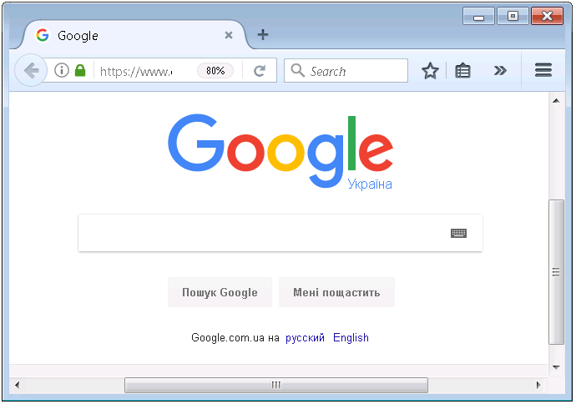
Locators Usage Example (1/3)

Slide 35
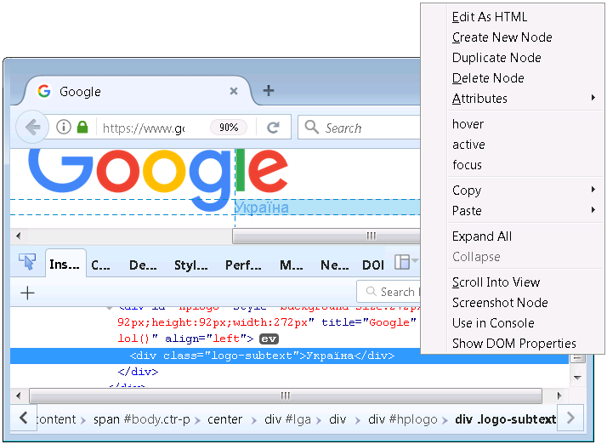
Locators Usage Example (2/3)
Pick up the desired element & Copy → CSS Selector
CSS Selector:
.logo-subtext

Slide 36
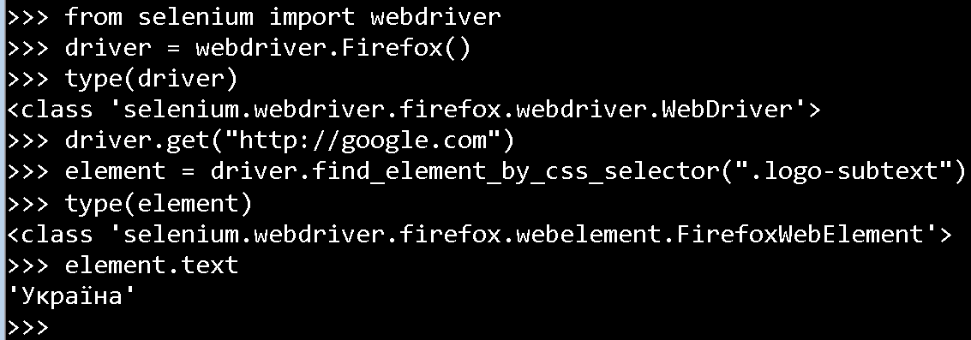
Locators Usage Example (3/3)
The full sequence:

Slide 37
Multiple Actions Example (1/2)
Opening pages
driver.get("http://www.google.com");
WebDriver will wait until the page is fully loaded (event "onload");
Element defined in the HTML code
<input type="text" name="passwd" id="passwd-id" />
You can find WebElement element:
element = driver.find_element_by_id("passwd-id")
element = driver.find_element_by_name("passwd")
element = driver.find_element_by_xpath(
"//input[@id='passwd-id']")

Slide 38
Multiple Actions Example (2/2)
Enter some text
element.send_keys("text")
Simulate clicking the arrows on your keyboard
element.send_keys("any text", Keys.ARROW_DOWN)
element.clear( )
driver.find_element_by_id("submit")).click( )
Switching between windows and frames
driver.switch_to( ).window("windowName")
for handle in driver.get_window_handles( ):
driver.switch_to( ).window(handle)
alert = driver.switch_to( ).alert( )

Slide 39
WebDriver API

Slide 40
Classes Represented Browsers
from selenium import webdriver
webdriver.Firefox
webdriver.FirefoxProfile
webdriver.Chrome
webdriver.ChromeOptions
webdriver.Ie
webdriver.Opera
webdriver.PhantomJS
webdriver.Remote
webdriver.DesiredCapabilities
webdriver.ActionChains
webdriver.TouchActions
webdriver.Proxy

Slide 41
Navigating Use Cases
Interacting with the page
Filling in forms
Drag and drop
Moving between windows and frames
Popup dialogs
history and location
Cookies
See for examples: http://selenium-python.readthedocs.io/navigating.html

Slide 42
Locating Elements (1/2)
Identification of the elements is done by driver’s methods:
find_element_by_id
find_element_by_name
find_element_by_xpath
find_element_by_tag_name
find_element_by_class_name
find_element_by_css_selector
find_element_by_link_text
find_element_by_partionalLinkText
Each “find_element_” method has its “find_elements_” double returning a list of elements

Slide 43
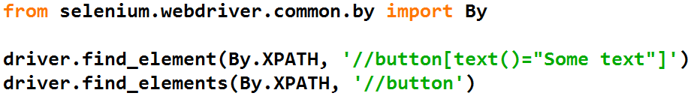
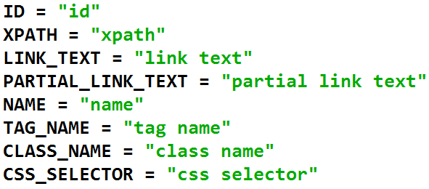
Locating Elements (2/2)
Class By could be used to specify locator strategies:
Available strategies:

Slide 44
Utilities
Functions from module selenium.webdriver.common.utils :
find_connectable_ip(host, port=None) - Resolve a hostname to an IP returned as a string
free_port() - Determines a free port using sockets.
is_connectable(port, host='localhost') - Tries to connect to the server at port to see if it is running.
is_url_connectable(port) - Tries to connect to the HTTP server at /status path and specified port to see if it responds successfully.
join_host_port(host, port) - Joins a hostname and port together.
keys_to_typing(value) - Processes the values that will be typed in the element.

Slide 45
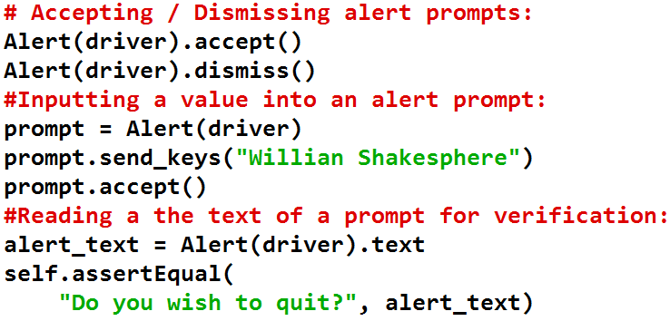
Alerts (1/2)
Class selenium.webdriver.common.alert.Alert(driver) allows to work with alerts.
Use this class to interact with alert prompts. It contains methods for dismissing, accepting, inputting, and getting text from alert prompts.

Slide 46
Alerts (2/2)
Alert methods:
accept() - Accepts the alert available.
authenticate(username, password) - Sends the username/password to an Authenticated dialog (like with Basic HTTP Auth) and clicks ‘OK’
dismiss() - Dismisses the alert available.
send_keys(keysToSend) - Send Keys to the Alert.

Slide 47
Special Keys Class
from selenium.webdriver.common.keys import Keys
ActionChains(driver).key_down(Keys.CONTROL)
.send_keys('c').key_up(Keys.CONTROL).perform()
ADD | CANCEL | END | F2 | HELP | MULTIPLY | NUMPAD6 | RIGHT
ALT | CLEAR | ENTER | F3 | HOME | NULL | NUMPAD7 | SEMICOLON
ARROW_DOWN | COMMAND | EQUALS | F4 | INSERT | NUMPAD0 | NUMPAD8 | SEPARATOR
ARROW_LEFT | CONTROL | ESCAPE | F5 | LEFT | NUMPAD1 | NUMPAD9 | SHIFT
ARROW_RIGHT | DECIMAL | F1 | F6 | LEFT_ALT | NUMPAD2 | PAGE_DOWN | SPACE
ARROW_UP | DELETE | F10 | F7 | LEFT_CONTROL | NUMPAD3 | PAGE_UP | SUBTRACT
BACKSPACE | DIVIDE | F11 | F8 | LEFT_SHIFT | NUMPAD4 | PAUSE | TAB
BACK_SPACE | DOWN | F12 | F9 | META | NUMPAD5 | RETURN | UP

Slide 48
Action Chains Class (1/3)
ActionChains are a way to automate low level interactions such as mouse movements, mouse button actions, key press, and context menu interactions. This is useful for doing more complex actions like hover over and drag and drop.
When you call methods for actions on the ActionChains object, the actions are stored in a queue in the ActionChains object.
When you call perform(), the events are fired in the order they are queued up.

Slide 49
Action Chains Class (2/3)
click
click_and_hold
context_click
double_click
drag_and_drop
drag_and_drop_by_offset
key_down
key_up
move_by_offset
move_to_element
move_to_element_with_offset
perform
release
send_keys
send_keys_to_element

Slide 50
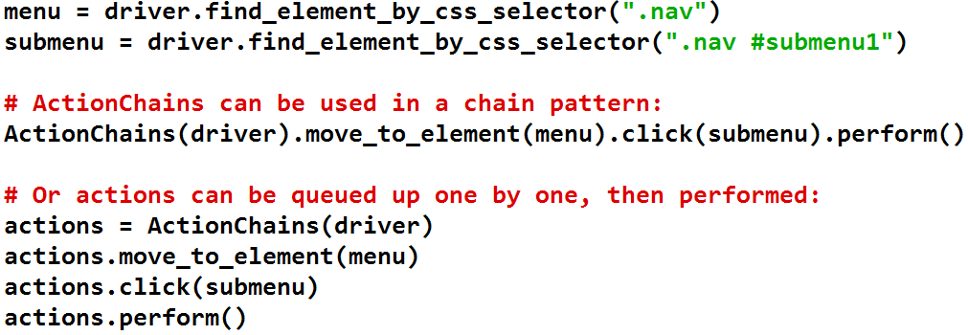
Action Chains Class (3/3)
Chained and “one-by-one” approaches:

Slide 51
Exception Classes (1/2)
All special exceptions are located in module:
selenium.common.exceptions
Common syntax:
selenium.common.exceptions.SomeException(
msg=None,
screen=None,
stacktrace=None
)

Slide 52
Exception Classes (2/2)
WebDriverException
InvalidElementStateException
ElementNotSelectableException
ElementNotVisibleException
NoSuchElementException
InvalidSelectorException
ErrorInResponseException
ImeActivationFailedException
ImeNotAvailableException
InvalidCookieDomainException
InvalidSwitchToTargetException
NoSuchFrameException
NoSuchWindowException
MoveTargetOutOfBoundsException
NoAlertPresentException
NoSuchAttributeException
RemoteDriverServerException
StaleElementReferenceException
TimeoutException
UnableToSetCookieException
UnexpectedAlertPresentException
UnexpectedTagNameException

Slide 53

References and Sources
https://en.wikipedia.org/wiki/Firebug_(software)
http://getfirebug.com/wiki/index.php/Firebug_Links
http://www.w3resource.com/web-development-tools/firebug-tutorials.php
http://www.seleniumhq.org/download/maven.jsp
https://www.youtube.com/watch?v=gsHyDIyA3dg
http://selenium-python.readthedocs.io/

Slide 54

Thank you!

